Slide 1
Interview Preparations
Normalization, de normalization, first form , second form , third form, what is snowpipe, task , streams, kafka queue, what is modeling, dbt modeling what is spark, how to work on that

Slide 2
Normalization, De normalization
the process of reorganizing data within a database so that users can utilize it for further queries and analysis. (Normalised data)
eliminating redundant and unstructured data and making the data appear similar across all records and fields.
all phone numbers to include dashes (2345678910 becomes 234-567-8910) or all s
Normalization is the technique of dividing the data into multiple tables to reduce data redundancy and inconsistency and to achieve data integrity. On the other hand, Denormalization is the technique of combining the data into a single table to make data retrieval faster.tates to be abbreviated (California becomes CA).

Slide 3
What is the difference between snowflake and star data schema?
In a star schema, relationships between tables are represented by a single join, resulting in a simple data structure for fast query performance and easy data analysis. The snowflake schema has a complex data structure with multiple levels of relationships between tables, represented by multiple joins.
Star schema is the fundamental schema among the data mart schema and it is simplest. This schema is widely used to develop or build a data warehouse and dimensional data marts. It includes one or more fact tables indexing any number of dimensional tables. The star schema is a necessary cause of the snowflake schema. It is also efficient for handling basic queries.
It is said to be star as its physical model resembles to the star shape having a fact table at its center and the dimension tables at its peripheral representing the star’s points. Below is an example to demonstrate the Star Schema:

Slide 4
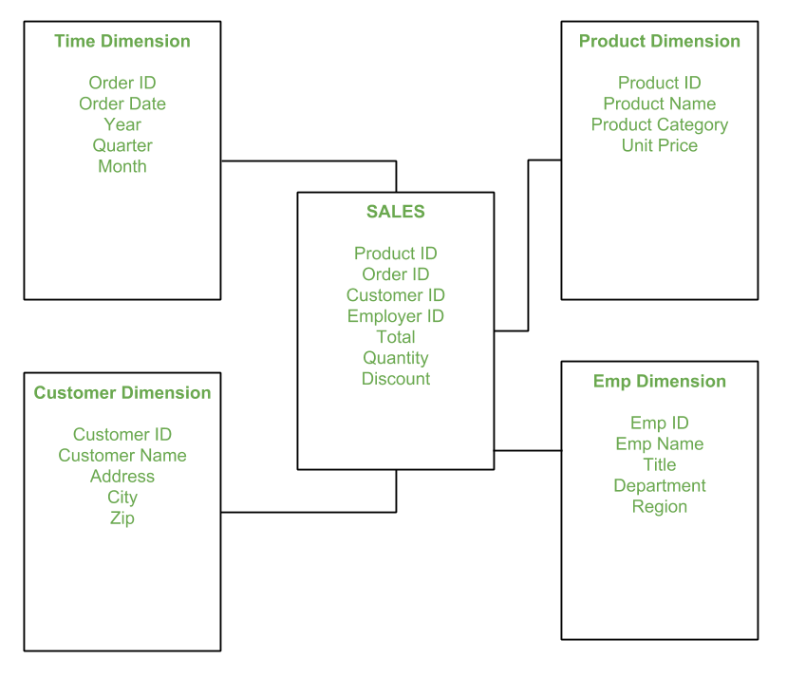
Star Schema

Slide 5
Model of Star Schema : In Star Schema, Business process data, that holds the quantitative data about a business is distributed in fact tables, and dimensions which are descriptive characteristics related to fact data. Sales price, sale quantity, distant, speed, weight, and weight measurements are few examples of fact data in star schema. Often, A Star Schema having multiple dimensions is termed as Centipede Schema. It is easy to handle a star schema which have dimensions of few attributes.

Slide 6
Advantages of star
Simpler Queries –
Simplified Business Reporting Logic –
Disadvantages of Star Schema – ’
Data integrity is not enforced well since in a highly de-normalized schema state.
Not flexible in terms if analytical needs as a normalized data model.

Slide 7
Features
Central fact table:
Dimension tables:
Denormalized structure: A star schema is denormalized, which means that redundancy is allowed in the schema design to improve query performance. This is because it is easier and faster to join a small number of tables than a large number of tables.
Simple queries:
Aggregated data: The numerical data in the fact table is usually aggregated at different levels of granularity, such as daily, weekly, or monthly. This allows for analysis at different levels of detail.
Fast Performance
Easy to Understand

Slide 8
What is Database Design? Database design is a collection of steps that help create, implement, and maintain a business's data management systems. The primary purpose of designing a database is to produce physical and logical models of designs for the proposed database system
What are the 4 types of database model?
Relational model. Network model. Object-oriented database model. Entity-relationship model.
What are the 5 steps under data modeling?
Requirements analysis.
Conceptual modeling.
Logical modeling.
Physical modeling.
Maintenance and optimization.

Slide 9
What is the ETL process?
Extract, transform, and load (ETL) is the process of combining data from multiple sources into a large, central repository called a data warehouse. ETL uses a set of business rules to clean and organize raw data and prepare it for storage, data analytics, and machine learning (ML).
What is cloud data warehouses?
A cloud data warehouse is a modern way of storing and managing large amounts of data in a public cloud. It lets you quickly access and use your data. This makes it the perfect solution for businesses that rely on data and require agility, flexibility, and ease of use for their infrastructure requirements.

Slide 10
What is event-driven data pipeline?
It allows organizations to track and detect “events” (valuable business moments such as customer transactions) and then instantly act on these events. EDA is different from a traditional request-driven system, where services needed to wait for a reply before processing the next task.
A data pipeline is a set of steps that moves data from one system to another. Different types of data pipelines perform different operations through the data transit.
Standard data pipelines include:
Batch data pipeline: A batch data pipeline periodically transfers bulk data from source to destination. It’s also a common choice for ELT or ETL processing.
Streaming data pipeline: A streaming data pipeline continually flows data from source to destination while translating the data into a receivable format in real-tim
ETL refers to a set of processes extracting data from one system, transforming it, and loading it into a target system. A data pipeline is a more generic term; it refers to any set of processing that moves data from one system to another and may or may not transform it.
What is an ETL pipeline?
An ETL pipeline is simply a data pipeline that uses an ETL strategy to extract, transform, and load data. Here data is typically ingested from various data sources such as a SQL or NoSQL database, a CRM or CSV file, etc.
The data is then transformed in a staging area that’s sole purpose is to prepare the data into the format best suited for the data target (typically a data warehouse or database). Let’s explore some common ETL data pipeline transformations to understand better how these types of data pipelines are used today.

Slide 11
Is Kafka a queue system?
Kafka and RabbitMQ are message queue systems you can use in stream processing. A data stream is high-volume, continuous, incremental data that requires high-speed processing.
How Kafka works?
Within Kafka, each unit of data in the stream is called a message. Messages could be clickstream data from a web app, point-of-sale data for a retail store, user data from a smart device, or any other events that underlie your business. Applications that send the message stream into Kafka are called producers.
Which data modeling concepts can be used in Snowflake?
The Snowflake's platform is ANSI SQL-compliant, allowing customers to leverage a wide selection of data modeling tools tailored to specific needs and purposes. Snowflake also has introduced a VARIANT data type for semi-structured data storage (AVRO, JSON, XML, Parquet, and others).

Slide 12
dbt (Data Building Tool) ETL tool is an open-source data transformation tool that allows data analysts and engineers to easily modify the data in their warehouses by writing simple transformation select statements.
What are the 5 steps of the ETL process? Extract, Clean, Transform, Load, and Analyze.
What is DBT tool used for?
dbt, or data build tool, is an open-source command-line tool that helps organizations build, test, and maintain their data infrastructure. The tool is designed to make it easier for data analysts and engineers to work with data, by providing a consistent and standardized approach to data transformation and analysis.

Slide 13
What are the advantages of first normal form?
A table that is normalized to the first normal form has these advantages:
It allows you to create any number of orders for each customer without having to add new columns.
It allows you to query and sort data for orders very quickly because you search only one column—Order Number.
What is second normal form with an example?
Note – 2NF tries to reduce the redundant data getting stored in memory. For instance, if there are 100 students taking C1 course, we dont need to store its Fee as 1000 for all the 100 records, instead once we can store it in the second table as the course fee for C1 is 1000.06-Nov-2023
Data redundancy occurs when the same piece of data exists in multiple places, whereas data inconsistency is when the same data exists in different formats in multiple tables. Unfortunately, data redundancy can cause data inconsistency, which can provide a company with unreliable and/or meaningless information.
The first normal form helps to eliminate duplicate data and simplify queries. Second Normal Form (2NF): 2NF eliminates redundant data by requiring that each non-key attribute be dependent on the primary key. This means that each column should be directly related to the primary key, and not to other columns.

Slide 14
The third normal form (3NF) is a means of organizing database tables by removing the transitive dependencies from a relational system. In transitive dependence, the value of a column or field within a table relies on another column in that same table, which is facilitated through another column located between them

Slide 15
SCD
SCDs are considered and implemented as one of the most critical ETL/ELT tasks in tracking the history of dimension records. For example, if we have a fact and dimension tables, the fact table is linked to the dimension tables with the help of foreign keys. If any of the dimension table data changes, we have to keep track of the data changes for reporting purposes.

Slide 16
Type-0
Simple and no special action is required.
This type is pretty simple and doesn’t require any special action since type 0-dimensional table has the static data, the values remain the same forever.
Example – Date dimension table (static data)
Date | day | week_in_a_month | week_in_a_year
2021-01-18 | Monday | 4th week | 4th week
2021-02-18 | Thursday | 3rd week | 8th week

Slide 17
Type-1
Insert and overwrite (upsert).
In this type, all the brand new records will get inserted and any change to the existing record will overwrite the old value with a new one. No history data is maintained in this type.
Before the change:
Emp_id | Emp_name | state
1111 | Tom | MI
1212 | Adam | MN

Slide 18
Type -1
After the change:
Emp_id | Emp_name | state
1111 | Tom | AZ | Exisiting record, so overwritten the old value
1212 | Adam | MN
1818 | Frank | NY | New record, so inserted
Type-2
Insert a changed record.
In this type, insert all brand new records and all changed records will terminate with the end_date and set the current_flag_status to false. Create a new record for changed data values with open end_date and set the current_flag_status to true.
Each and every record has the effective date, end date, and flag status fields to identify in which time period the record was active.

Slide 19
Before and After change
Emp_id | Emp_name | state | Effective_date | end_date | current_flag_status
1111 | Tom | MI | 2020-10-08 | 9999-12-31 | True
1212 | Adam | MN | 2020-10-08 | 9999-12-31 | True
Emp_id | Emp_name | state | Effective_date | end_date | current_flag_status
1111 | Tom | MI | 2020-10-08 | 2021-10-09 | False | Old record terminated
1111 | Tom | AZ | 2020-10-09 | 9999-12-31 | True
1212 | Adam | MN | 2020-10-08 | 9999-12-31 | True

Slide 20
Type 3
Store the new and old values in current and previous fields.
In this method, we usually have current and previous value fields. The new value is ingested into the current field and the old value is ingested into Previous field.
Before the change:
Emp_id | Emp_name | current_state | Previous_state
1111 | Tom | MI | MI
1212 | Adam | MN | MN
Emp_id | Emp_name | current_state | Previous_state
1111 | Tom | AZ | MI
1212 | Adam | MN | MN

Slide 21
Type-4
Maintain data in separate tables (current table, history table).
In this method, we will maintain the data in two separate tables. All the current active data will be seen in the current table and all the history data will be seen in the history table with the effective and end date fields to determine in which time period the record was active.
Emp_id | Emp_name | state
1111 | Tom | AZ
Current table:
History table:
Emp_id | Emp_name | state | Effective_date | end_date
1111 | Tom | MI | 2020-10-08 | 2021-10-09

Slide 22
Type-6
Type 1 + Type 2 + Type 3 (Combined approach).
This method is a combination of Type 1 (insert and overwrite), Type 2 (insert a changed record), and Type 3 (store the new and old values in current and previous fields) approaches.

Slide 23
To sum up, Spark helps to simplify the challenging and computationally intensive task of processing high volumes of real-time or archived data, both structured and unstructured, seamlessly integrating relevant complex capabilities such as machine learning and graph algorithms.
Why use Spark for ETL?
ETL pipelines on Apache SparkTM are a popular choice for large-scale data processing for good reason: they can quickly handle incredible volumes of data, support parallel processing, offer a high-level API for easy data transformation, and have a strong ecosystem with many pre-built tools, connectors, and libraries.01

